Slide 1

A deep learning approach to detect seizures using EEG signals
Supervisor:
Prof. Dr. Md. Khademul Islam Molla, PhD
Author & Presented by:
Md. Abdullah Al Mamun(1810576118)

Slide 2



Agenda
Introduction & Background of the study
Research Questions
Proposed Methodology
Transformation of Input Signal
Experiment, Results and Discussion
Conclusion and Future Work

Slide 3
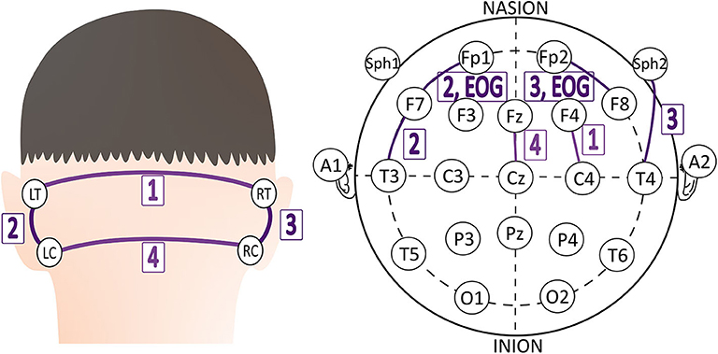
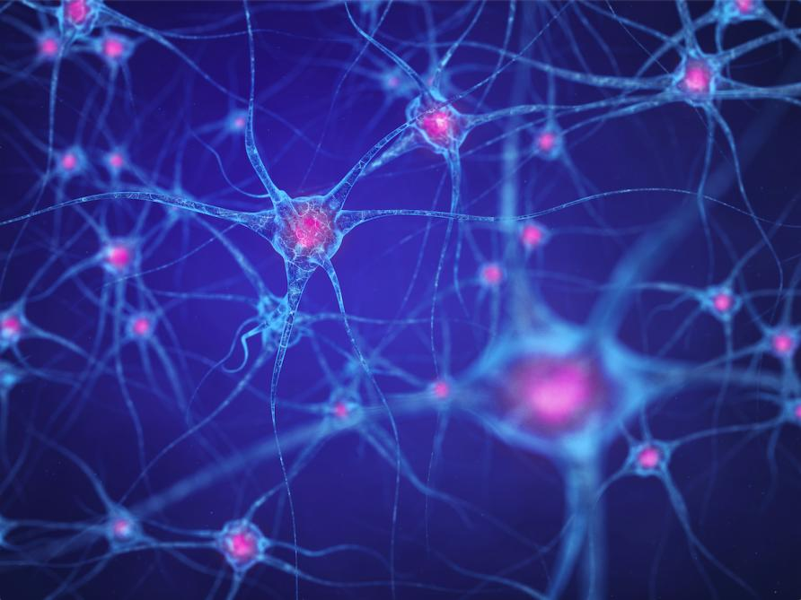




Introduction
• Emerging frontier in neuroscientific research
• Development and refinement of methodologies for seizure detection
• Deep learning and convolutional neural networks as promising techniques
• Imperative need for enhanced accuracy in seizure detection

Slide 4

Background of the study
• Focus on seizure detection using EEG signals and deep learning
• Importance of accurate and prompt seizure detection
• Interest of medical professionals and researchers in epilepsy and neurology

Slide 5

Research Questions
• How can EEG signals be effectively classified for seizure detection?
• What is the impact of different model configurations on performance?
• How does the proposed model compare with existing approaches?
This Photo by Unknown author is licensed under CC BY.​

Slide 6
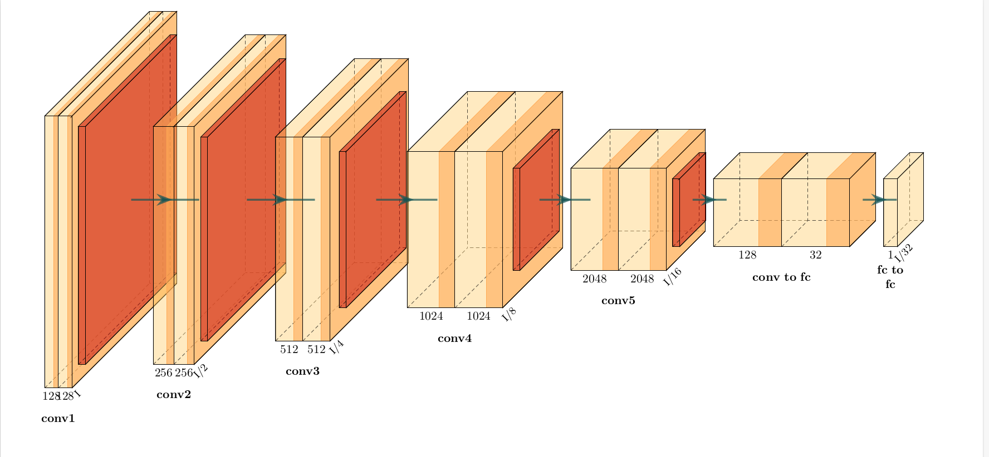
Proposed Methodology
• Development of a residual EEG model for EEG signal classification
• Training and evaluation of over 400 models
• Use of metrics such as accuracy, precision, recall, and F1 score for assessment

Slide 7
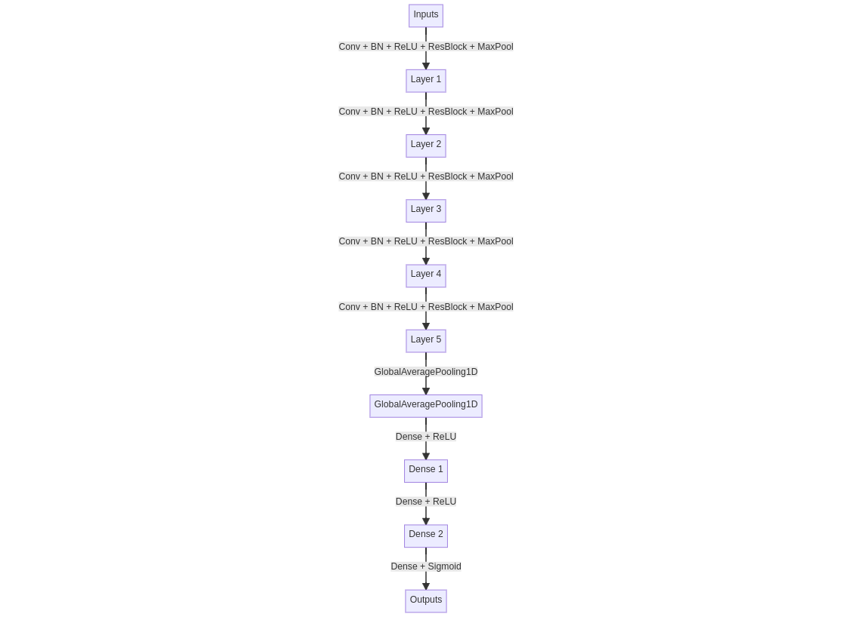
Proposed Methodology
• Iterative process starting with a simple artificial neural network (ANN)
• Experimentation with different activation functions, learning rates, and regularization
• Comprehensive exploration of different model configurations and training techniques

Slide 8
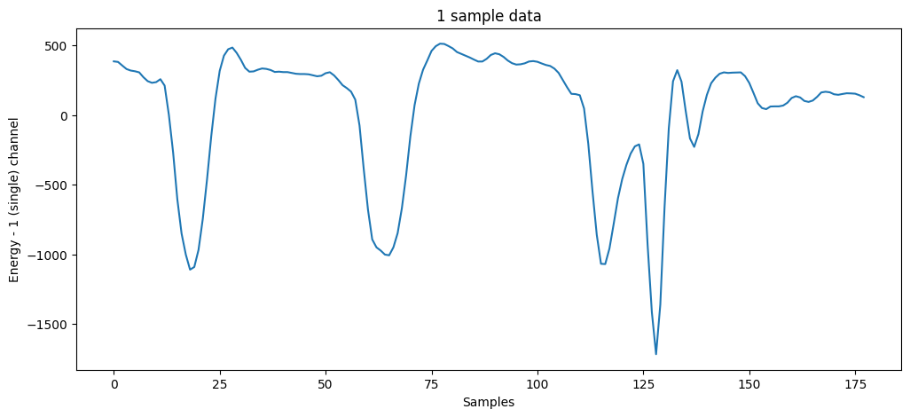
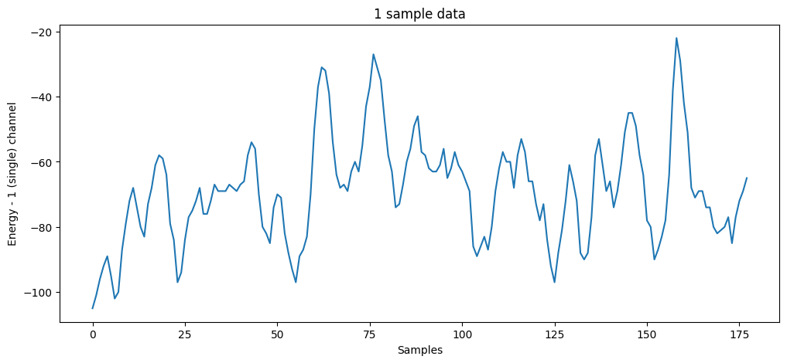
Transformation of Input Signal (input layer)
Seizure data
Non-Seizure data

Slide 9
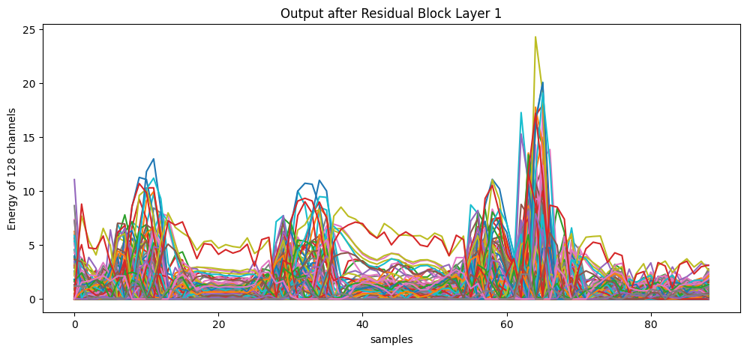
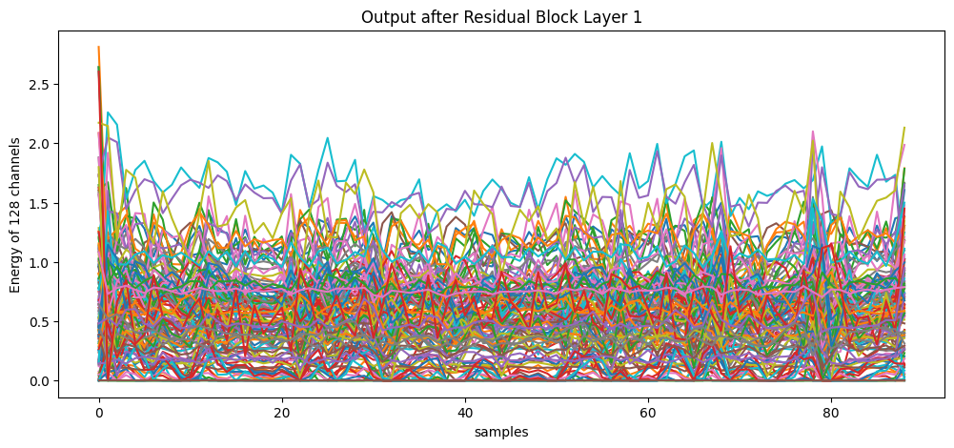
Transformation of Input Signal (Residual Block 1)
Seizure data
Non-Seizure data

Slide 10
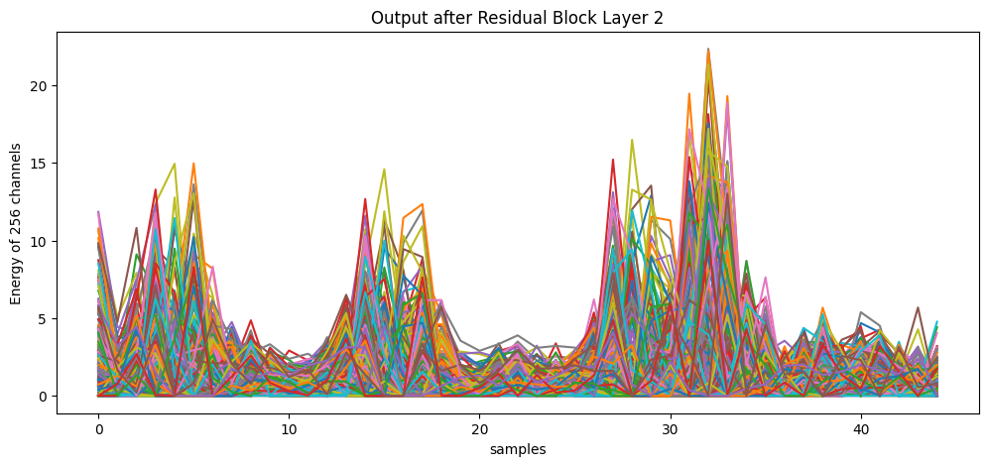
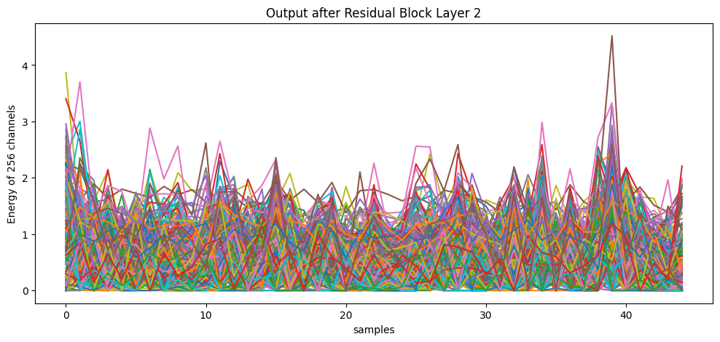
Transformation of Input Signal (Residual Block 2)
Seizure data
Non-Seizure data

Slide 11
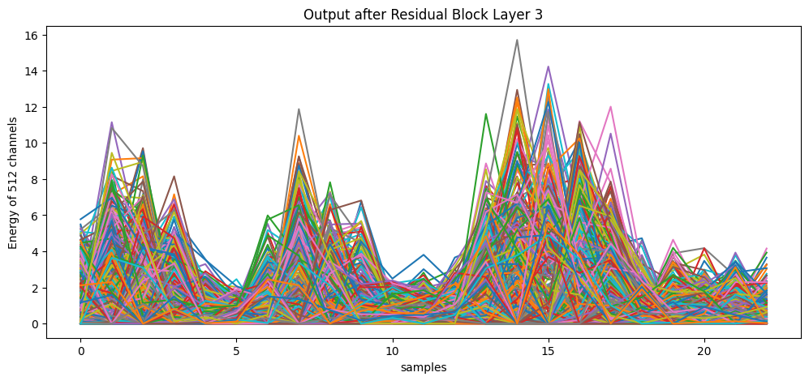
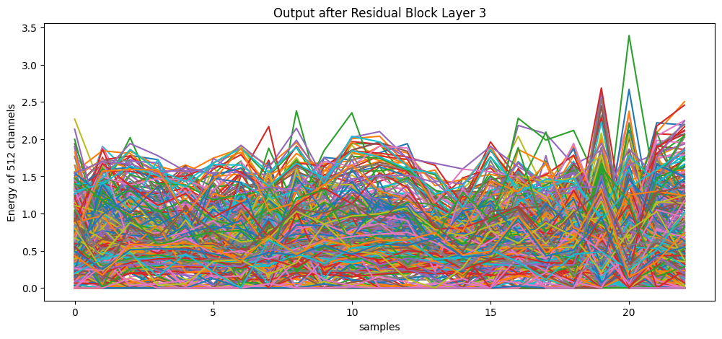
Transformation of Input Signal (Residual Block 3)
Seizure data
Non-Seizure data

Slide 12
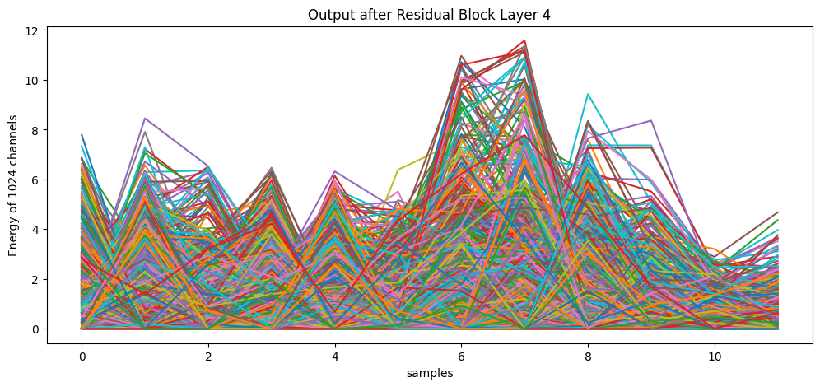
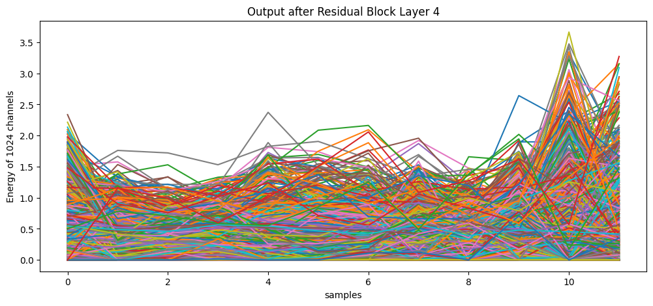
Transformation of Input Signal (Residual Block 4)
Seizure data
Non-Seizure data

Slide 13
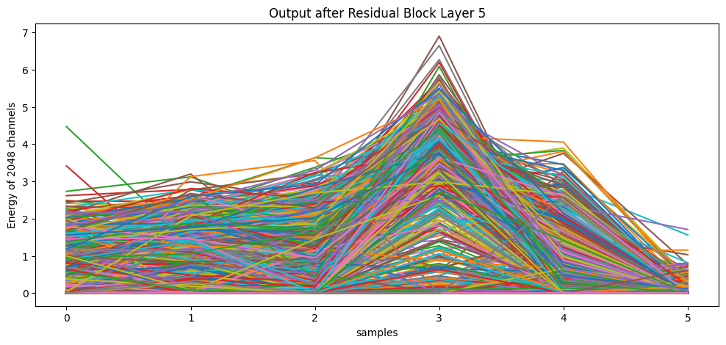
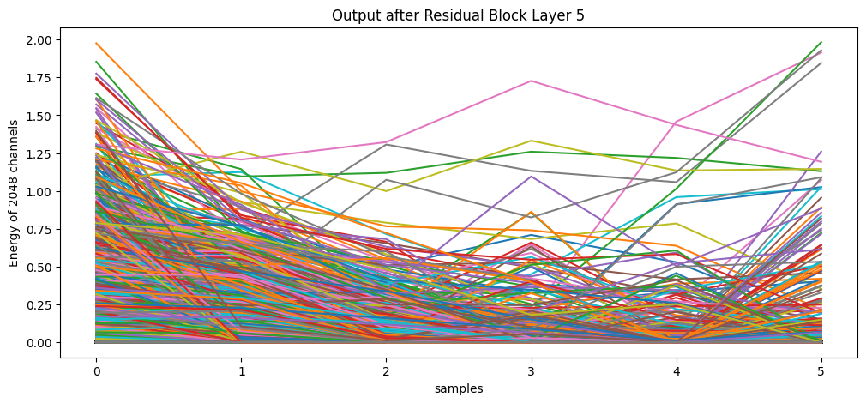
Transformation of Input Signal (Residual Block 5)
Seizure data
Non-Seizure data

Slide 14
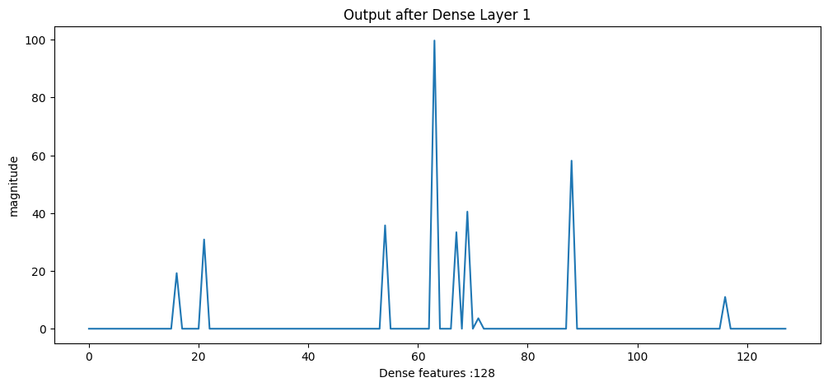
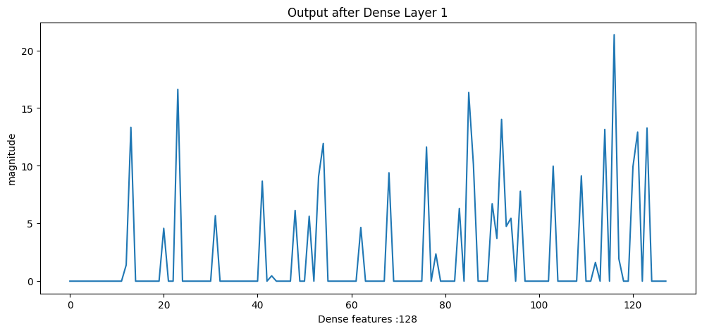
Transformation of Input Signal (Dense 1)
Seizure data
Non-Seizure data

Slide 15
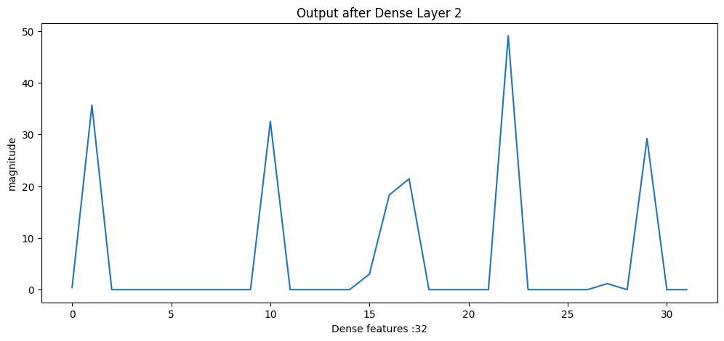
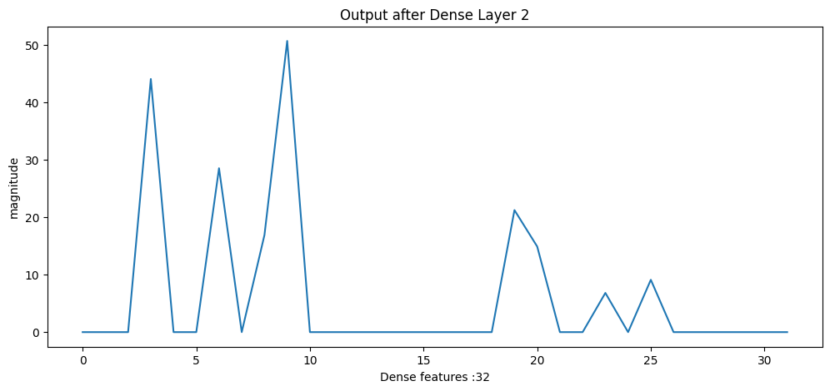
Transformation of Input Signal (Dense 2)
Seizure data
Non-Seizure data

Slide 16
STEPs USED TO Find BEST ARCHITECTURE
Artificial Neural Network(ANN)
Convolutional Neural Network(CNN) (Conv1d)
Recurrent Neural Network(RNN) and it’s different types (LSTM, GRU)
With Different Number of layers, units, kernel size, filter sizes
With well-known image classification techniques such as residual connection, hourglass technique

Slide 17
Different classification experiments
Seizure Vs EyesClosed (E vs B)
Seizure Vs Epileptogenic (E vs C)
Seizure Vs EyesOpen, EyesClosed (E vs AB)
Seizure Vs Hippocampus (E vs D)
Seizure Vs EyeOpen (E vs A)
Seizure Vs EyeOpen, Epileptogenic, Hippocampus (E vs ACD)
Seizure Vs Epileptogenic, Hippocampus (E vs CD)
Seizure Vs EyesClosed, Epileptogenic, Hippocampus (E vs BCD)
Seizure Vs All (E vs ABCD)

Slide 18
Results & Discussions
Experiment Name | Validation Accuracy | Validation Precision | Validation Recall | Validation F1_Score
Seizure Vs EyesClosed (E vs B) | 0.9995652 | 0.9991323 | 1.0 | 0.9995659
Seizure Vs Epileptogenic (E vs C) | 0.9978260 | 0.9973960 | 0.9982608 | 0.9978282
Seizure Vs EyesOpen EyesClosed (E vs AB) | 1.0 | 1.0 | 1.0 | 1.0
Seizure Vs Hippocampus (E vs D) | 0.9956521 | 0.9956530 | 0.9956521 | 0.9956526
Seizure Vs EyeOpen (E vs A) | 0.9997826 | 1.0 | 0.9995652 | 0.9997825
Seizure Vs EyeOpen Epileptogenic Hippocampus (E vs ACD) | 0.9973913 | 0.9960850 | 0.9934782 | 0.9947799
Seizure Vs Epileptogenic Hippocampus (E vs CD) | 0.9966666 | 0.9978146 | 0.9921739 | 0.9949862
Seizure Vs EyesClosed Epileptogenic Hippocampus (E vs BCD) | 0.9956530 | 0.9891304 | 0.9963996 | 0.9927517
Seizure Vs All (E vs ABCD) | 0.9965217 | 0.9978146 | 0.9921739 | 0.9949862
Average | 0.9975095 | 0.9964132 | 0.9965301 | 0.9967564

Slide 19
Results & Discussions
• High performance across all experiments
• Average validation accuracy, precision, recall, and F1 score of 0.9975, 0.9964, 0.9965, and 0.9968 respectively
• Significant advancement in the field of EEG signal classification
• Superior performance and robustness of the proposed model
• Promising tool for various applications, including seizure detection and brain-computer interfaces

Slide 20
Conclusion
• High performance suggests effective use in real-world applications
• Robustness of the model across different conditions
• Potential use in other types of signal classification tasks

Slide 21
Recommendations for Future Research
• Further optimization of the model
• Exploration of its application in other areas of neurology
• Potential as a valuable tool in a wide range of clinical and research scenarios

Slide 22


Thank You
Md. Abdullah Al Mamun
1810576118
Session: 2017-18
mamun.cseian@gmail.com

